Slide 1
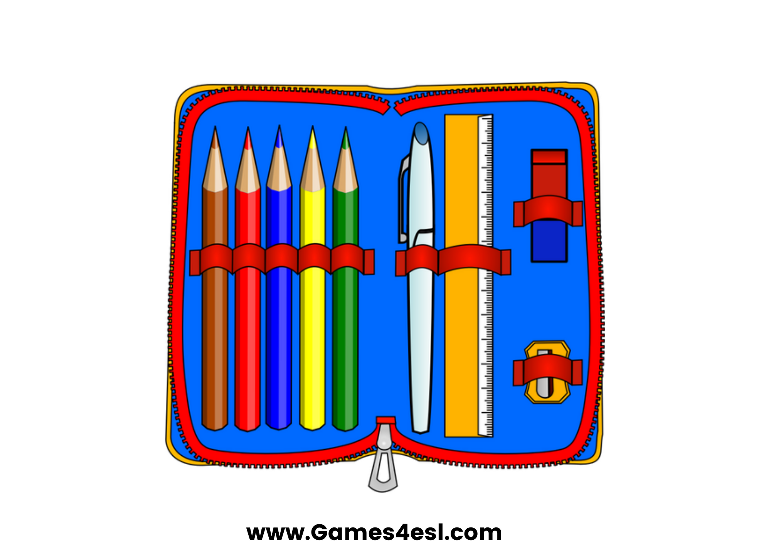
pencil case
SHOW

Slide 2
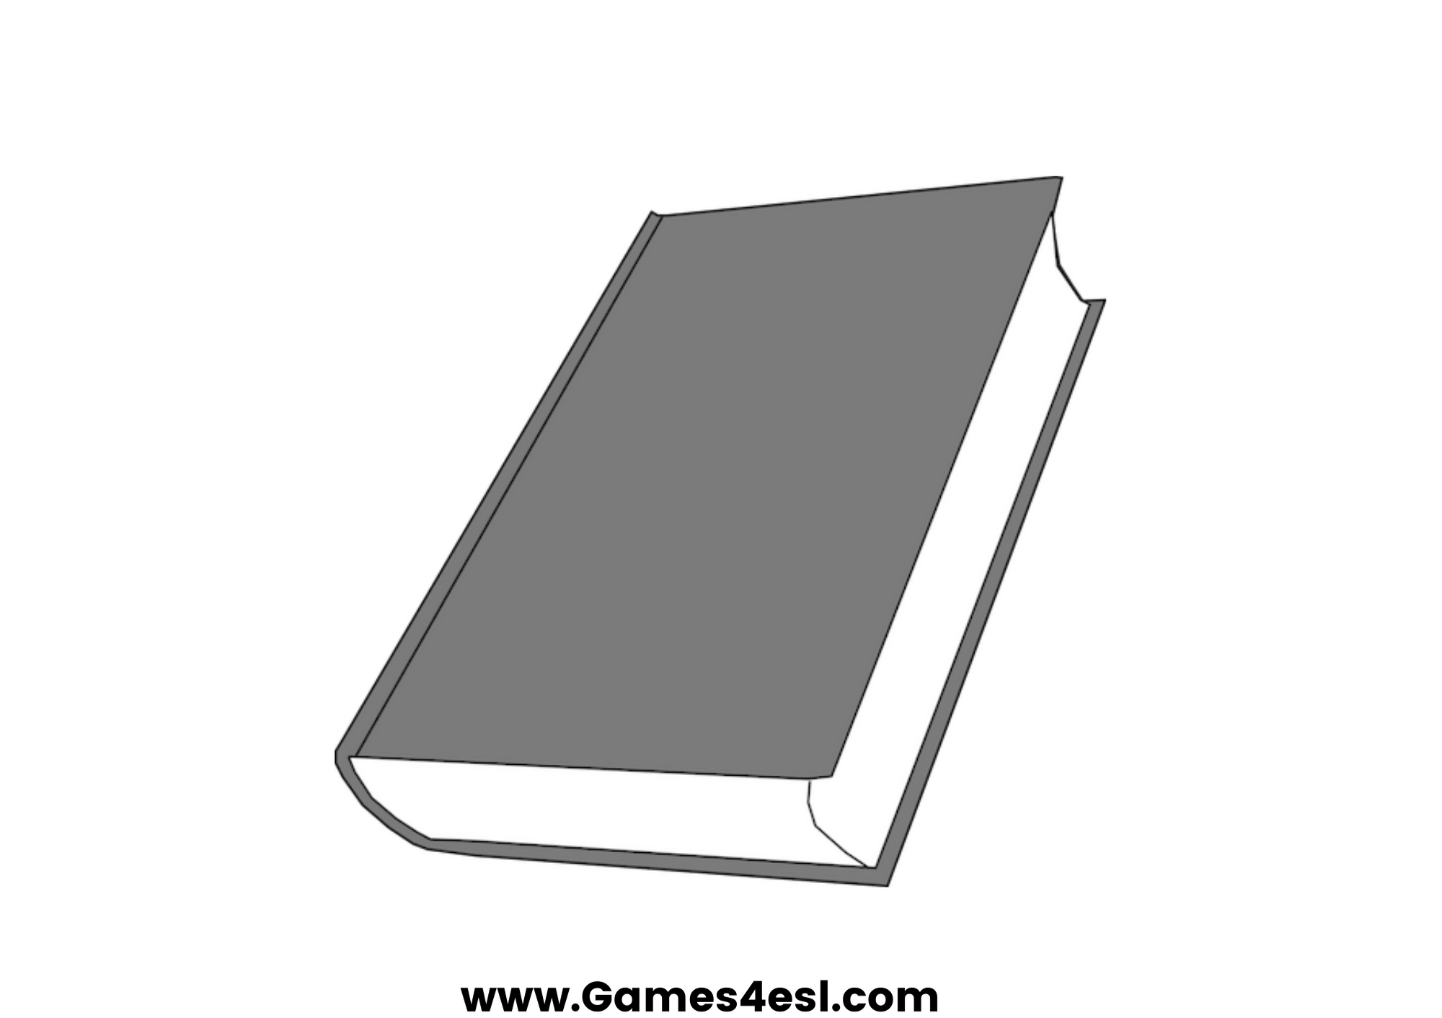
book
SHOW

Slide 3
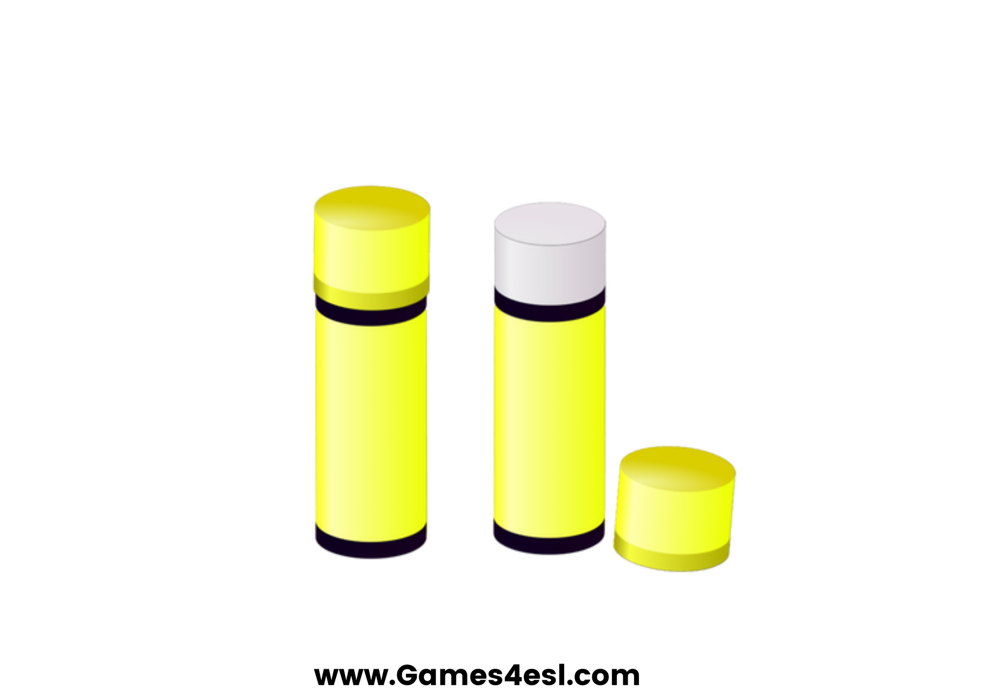
glue
SHOW

Slide 4
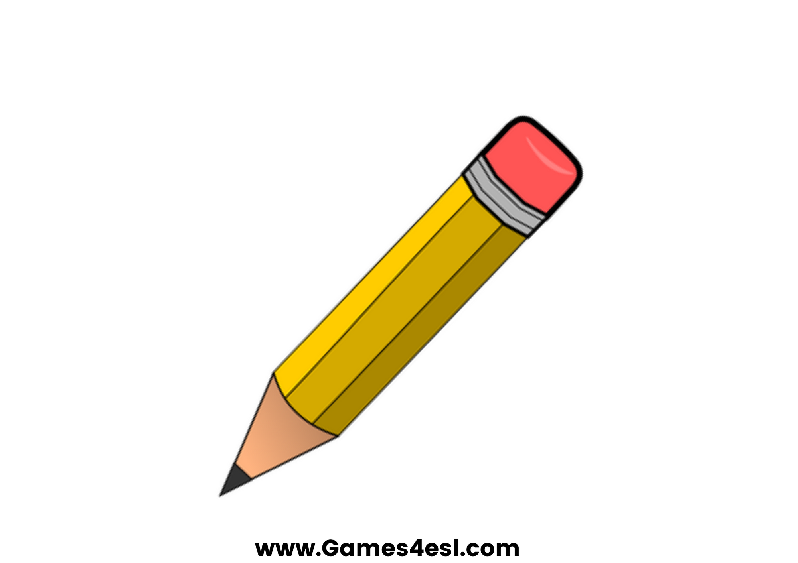
pencil
SHOW

Slide 5
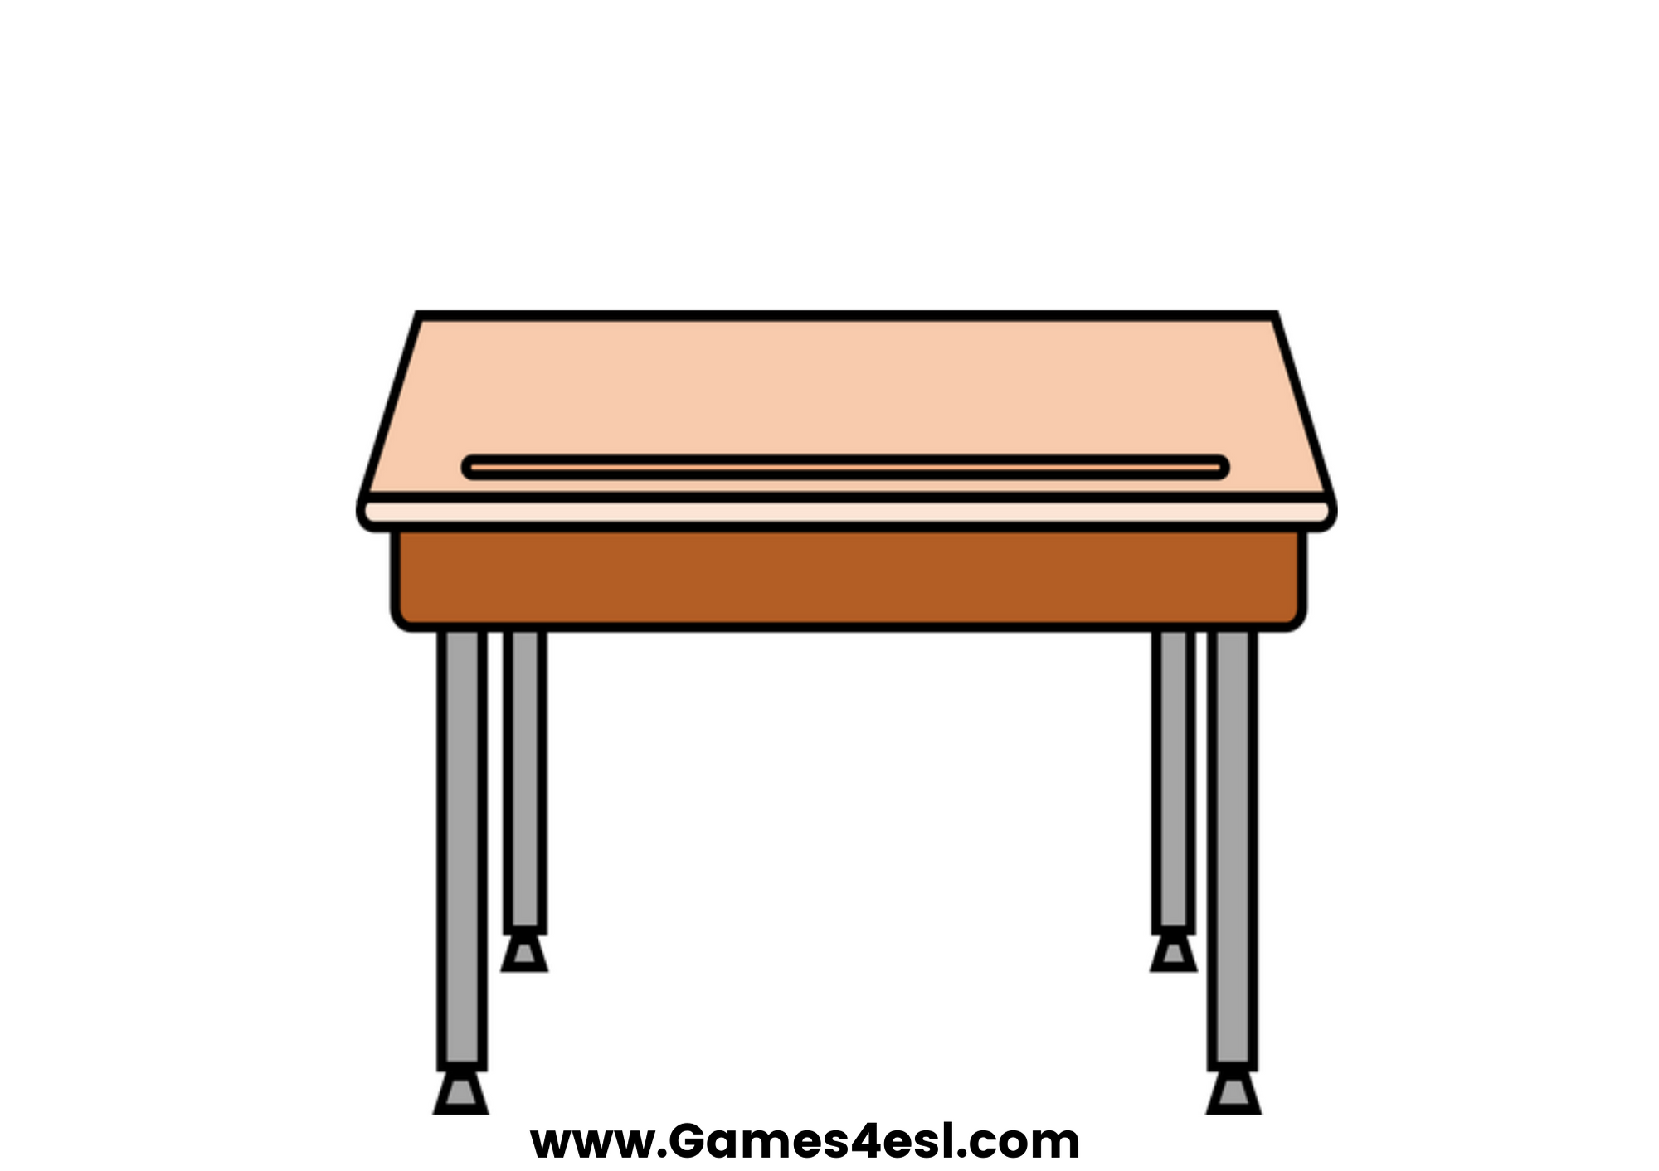
desk
SHOW

Slide 6

scissors
SHOW

Slide 7
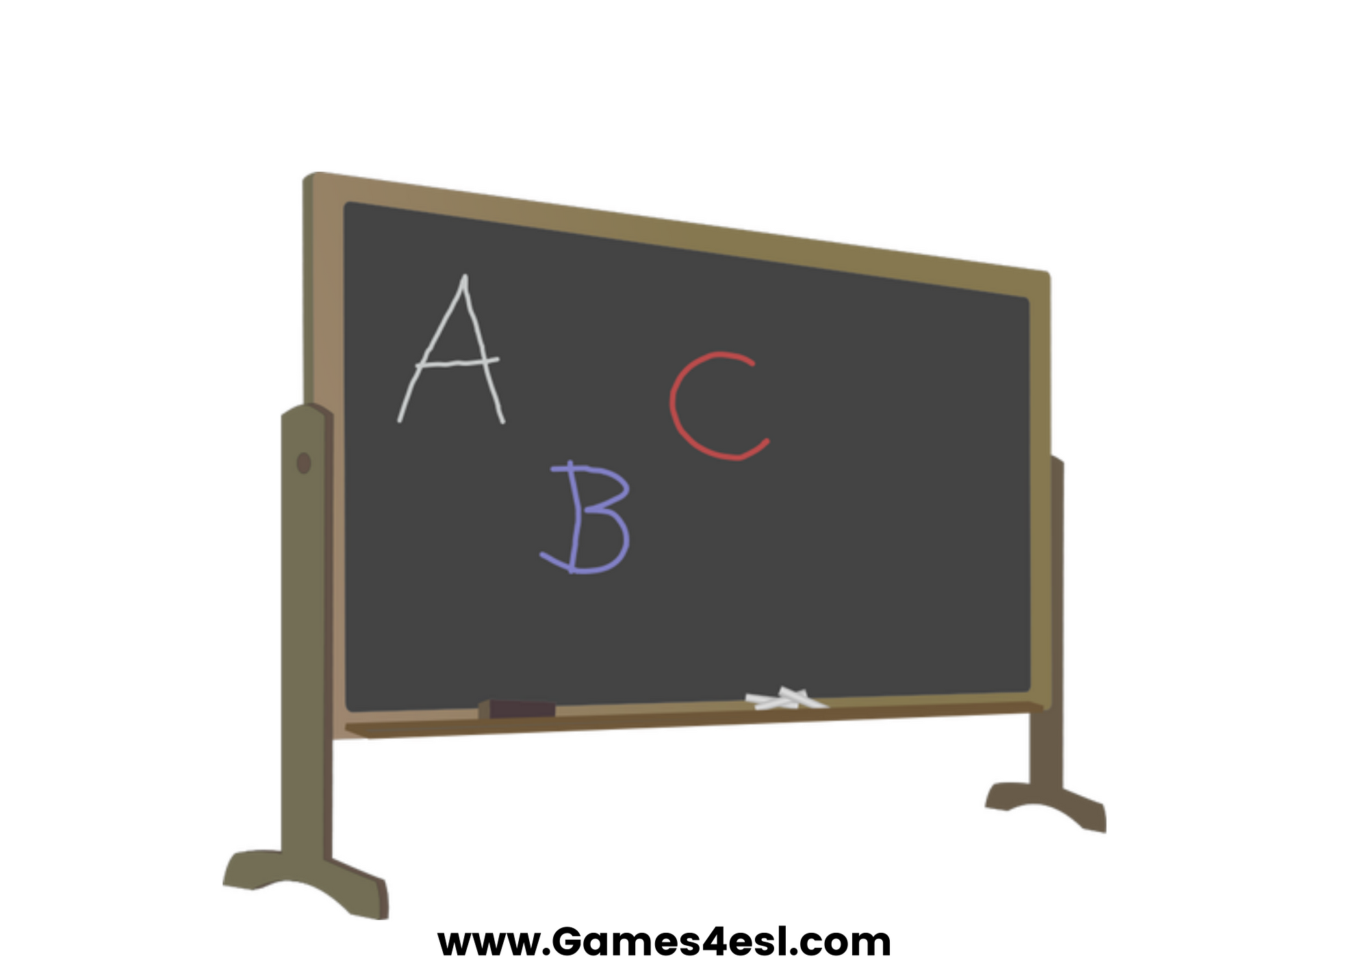
board
SHOW

Slide 8
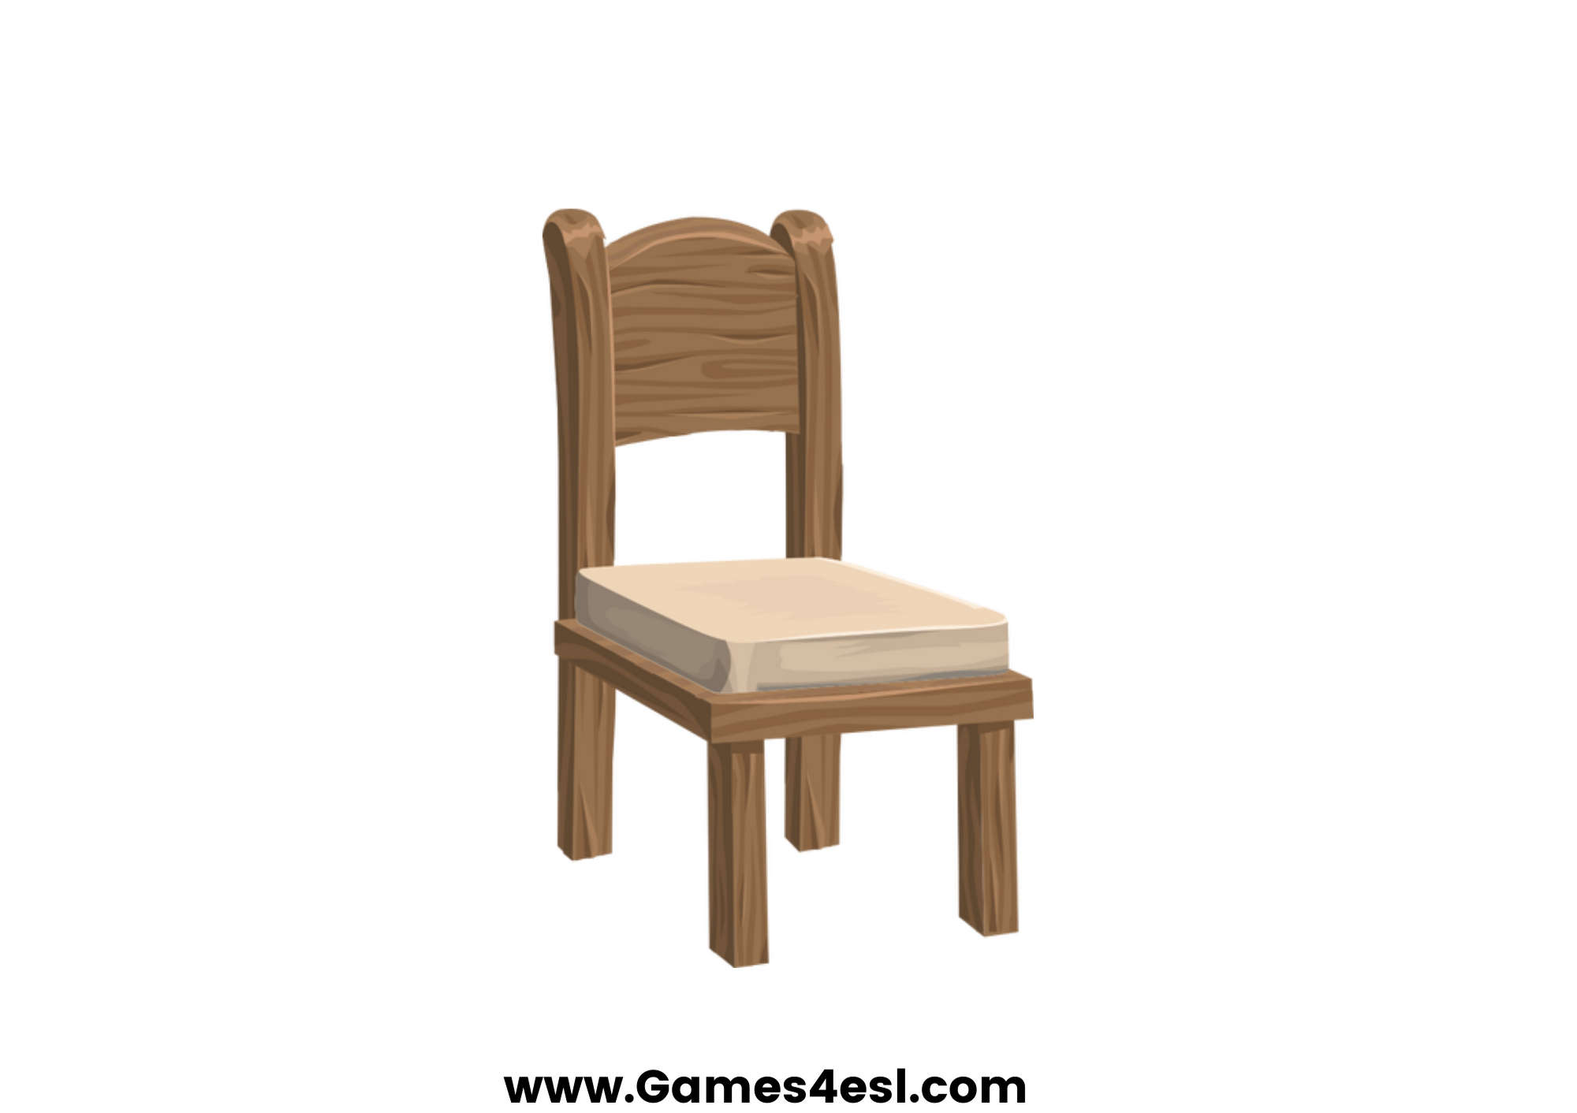
chair
SHOW

