Slide 1
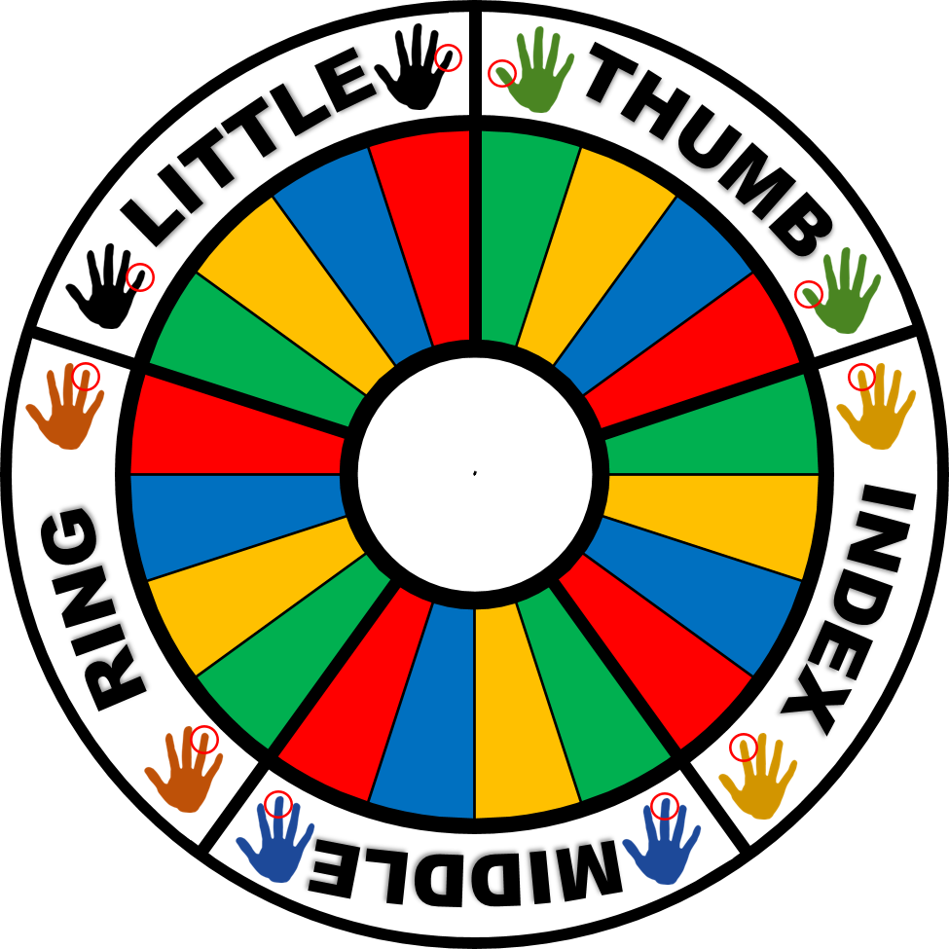

1
Green
1
Yellow
1
Blue
1
Red
2
Green
2
Yellow
2
Blue
2
Red
Spin!
3
Green
3
Yellow
3
Blue
3
Red
4
Green
4
Yellow
4
Blue
4
Red
tekhnologic

Slide 2
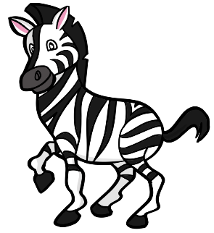

How many zebras can you see?
Can they fly?
1
Green
BACK
tekhnologic

Slide 3

How many lions can you see?
Can it jump?
2
Green
BACK
tekhnologic

Slide 4


How many tigers can you see?
Can they fly?
3
Green
BACK
tekhnologic

Slide 5

How many elephant can you see?
Can they talk?
4
Green
BACK
tekhnologic

Slide 6
1
Yellow
How many zebras can
you see?
Can they jump?
BACK
tekhnologic

Slide 7
2
Yellow
How many elephants can you see?
Can they talk?
BACK
tekhnologic

Slide 8
3
Yellow
How many lions can you see?
Can they run?
BACK
tekhnologic

Slide 9

4
Yellow
How many tigers can you see?
Can it climb?
BACK
tekhnologic

Slide 10
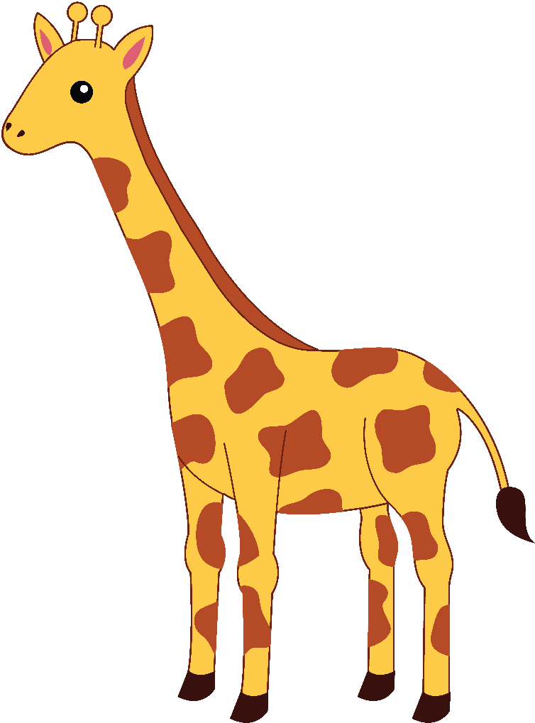
How many giraffes can you see?
Can they swim?
1
Blue
BACK
tekhnologic

Slide 11
2
Blue
How many tigers can you see?
Can they fly?
BACK
tekhnologic

Slide 12
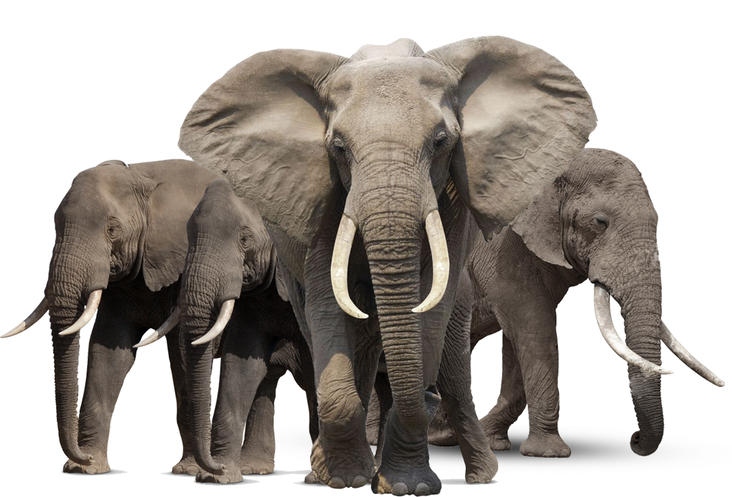
3
Blue
How many elephants can you see?
Can they fly?
BACK
tekhnologic

Slide 13
4
Blue
How many zebras can
you see?
Can it climb?
BACK
tekhnologic

Slide 14

1
Red
How many monkeys can
you see?
Can it climb?
BACK
tekhnologic

Slide 15

2
Red
How many penguins can
you see?
Can they fly?
BACK
tekhnologic

Slide 16

3
Red
How many parrots can
you see?
Can they fly?
BACK
tekhnologic

Slide 17

4
Red
How many hippos can you see?
Can it jump?
BACK
tekhnologic

