Slide 1

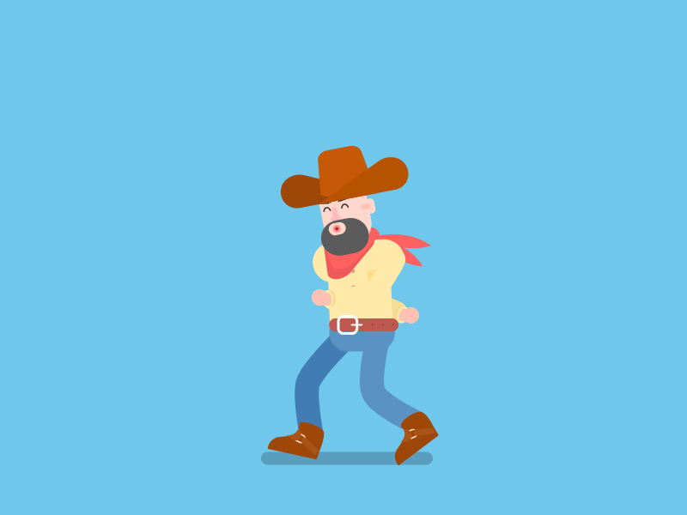

cape
make
base
late

Slide 2


robe
cone
go
hose

Slide 3


wise
hike
five
mine

Slide 4
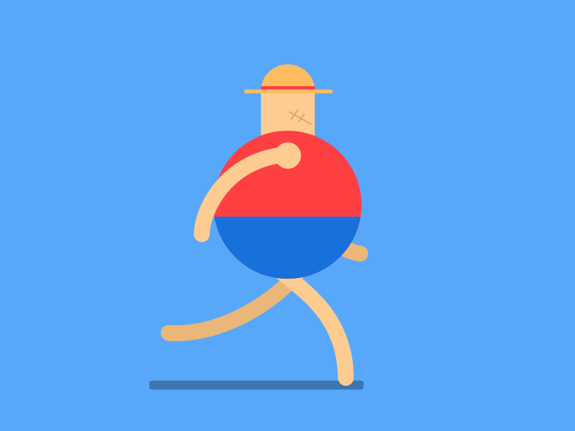

file
him
tape
top

Slide 5


pan
mop
rose
hen

Slide 6


duck
bike
lock
toe

