Slide 1
1
7
13
20
17
23
2
24
11
10
9
19
★
3
22
21
16
5
14
12
4
15
18
6
8
Notes:
Click on the information symbol to show horizontal, vertical and diagonal lines highlighted.

Slide 2
CHALLENGE
INTRODUCE YOURSELF
BACK

Slide 3
What are you doing ____ January 23rd?
A
AT
B
IN
C
ON
D
LAST
BACK
Notes:
Click on the answer, not the letter.

Slide 4
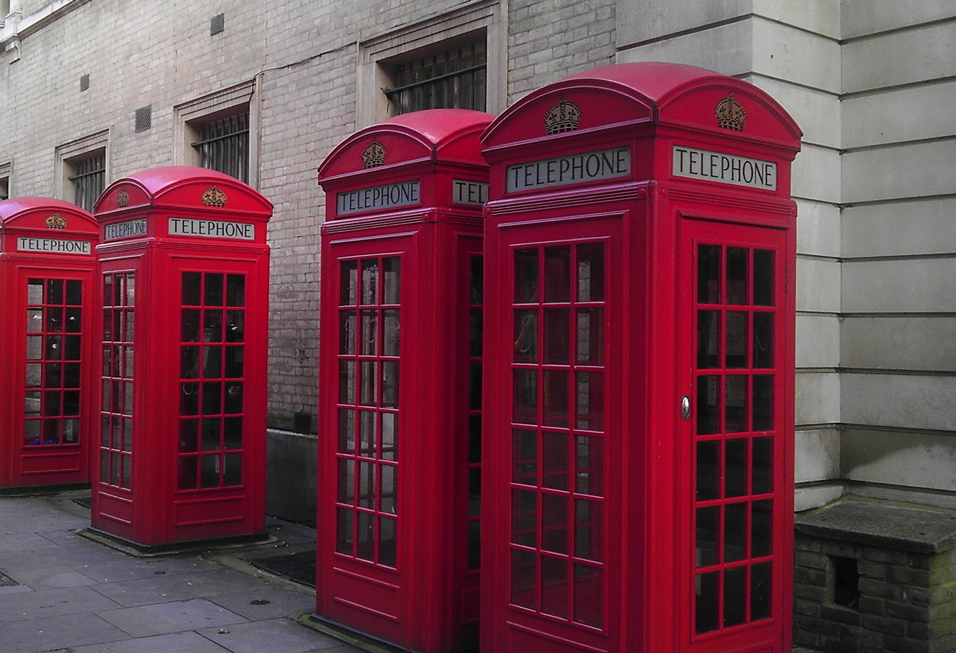
1
2
3
4
5
6
7
8
9
BACK

