Slide 1




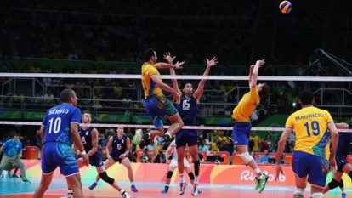
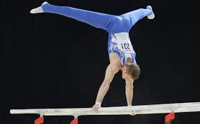

Show all
Fast
Medium
Slow
Hide all
tekhnologic
Notes:
Right-click on an image and select change picture.
Select your picture. Click on insert.
Start your presentation.
Click on Fast, Medium or Slow to show the series of images.
Click Show All to see all the images.
Click Hide All to hide all the images.

Slide 2


Show all
Fast
Medium
Slow
Hide all
tekhnologic
Notes:
Right-click on an image and select change picture.
Select your picture. Click on insert.
Start your presentation.
Click on Fast, Medium or Slow to show the series of images.
Click Show All to see all the images.
Click Hide All to hide all the images.

Slide 3





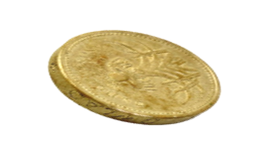
Show all
Fast
Medium
Slow
Hide all
tekhnologic
Notes:
Right-click on an image and select change picture.
Select your picture. Click on insert.
Start your presentation.
Click on Fast, Medium or Slow to show the series of images.
Click Show All to see all the images.
Click Hide All to hide all the images.

Slide 4




Show all
Fast
Medium
Slow
Hide all
tekhnologic
Notes:
Right-click on an image and select change picture.
Select your picture. Click on insert.
Start your presentation.
Click on Fast, Medium or Slow to show the series of images.
Click Show All to see all the images.
Click Hide All to hide all the images.

