Slide 1



BY HERBER

Slide 2

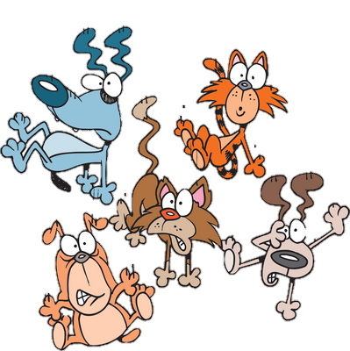
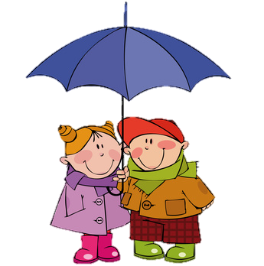
It’s raining cats and dogs.
Means …
A. Cats and dogs are falling from the sky.
B. It’s raining very hard.
C. There are a lot of pets.

Slide 3
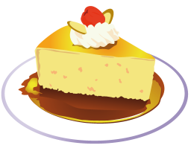
A piece of cake.
Means …
A. Something is very good.
B. Something is very beautiful.
C. Something is very easy.

Slide 4

As fresh as a daisy.
Means …
A. You are full of energy.
B. You are very young.
C. You are new
at somewhere.

Slide 5

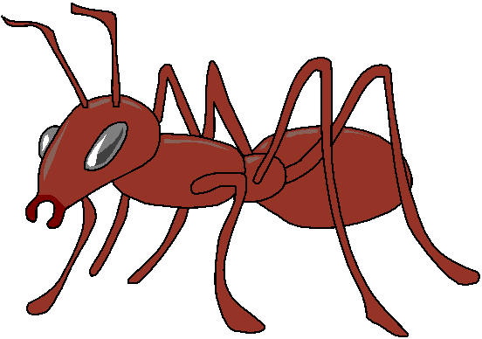
Have ants in your pants.
Means …
A. You collect insects.
B. You are sitting on the grass.
C. You are not able to sit still.

Slide 6
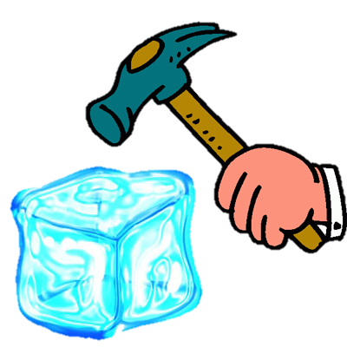
Break the ice.
Means …
A. You are very strong.
B. You are the first to do or say something.
C. You like cold drinks.

Slide 7
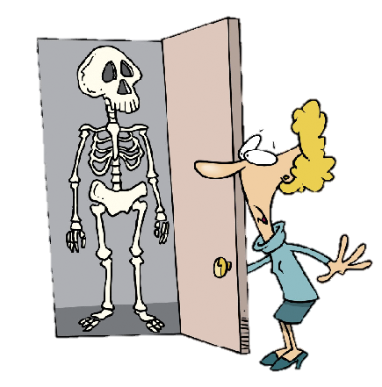
Skeletons in your closet.
Means …
A. You have secrets.
B. Your closet is full of skeletons.
C. You are not afraid of anything.

Slide 8
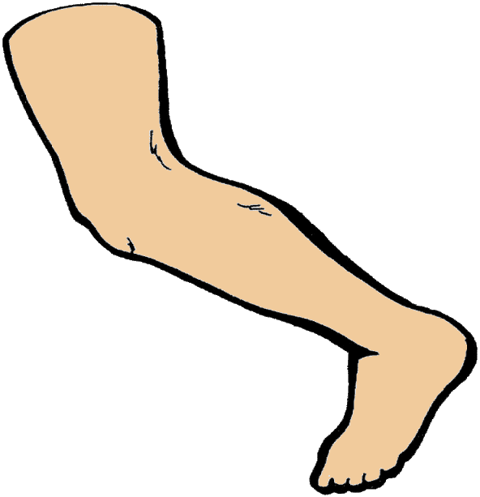
Shake a leg!
Means …
A. Dance with someone.
B. Hurry up!
C. Shake your leg to get a bug off of it.

Slide 9
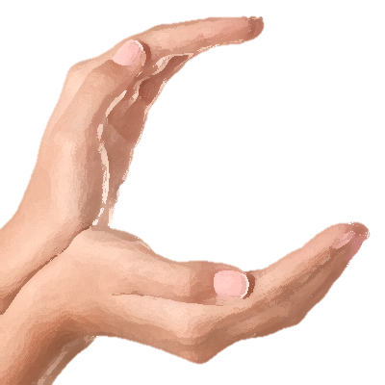
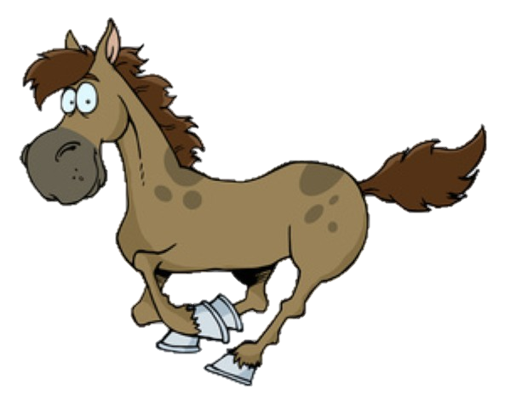
Hold your horses.
Means …
A. Ride a horse.
B. Stop your car.
C. Be patient.

Slide 10


On cloud nine.
Means …
A. Be very happy or excited.
B. Be confused.
C. Be on the ninth floor.

Slide 11

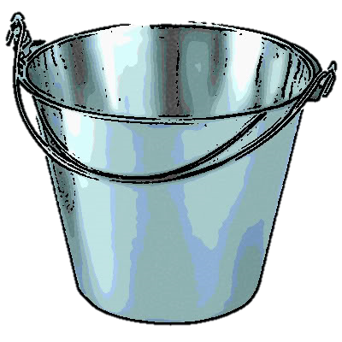
A drop in the bucket.
Means …
A. A very small part of something.
B. To be thirsty.
C. It's raining a little.

Slide 12
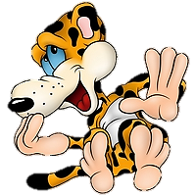
A leopard can't change his spots.
Means …
A. You are afraid of animals.
B. You are a rude person .
C. You cannot change who you are.

Slide 13
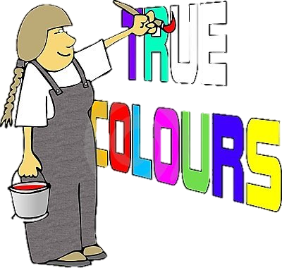
A picture paints a thousand words.
Means …
A. Make a picture with words.
B. A visual presentation is more descriptive than words.
C. Pictures must be described.
EXIT

