Slide 1
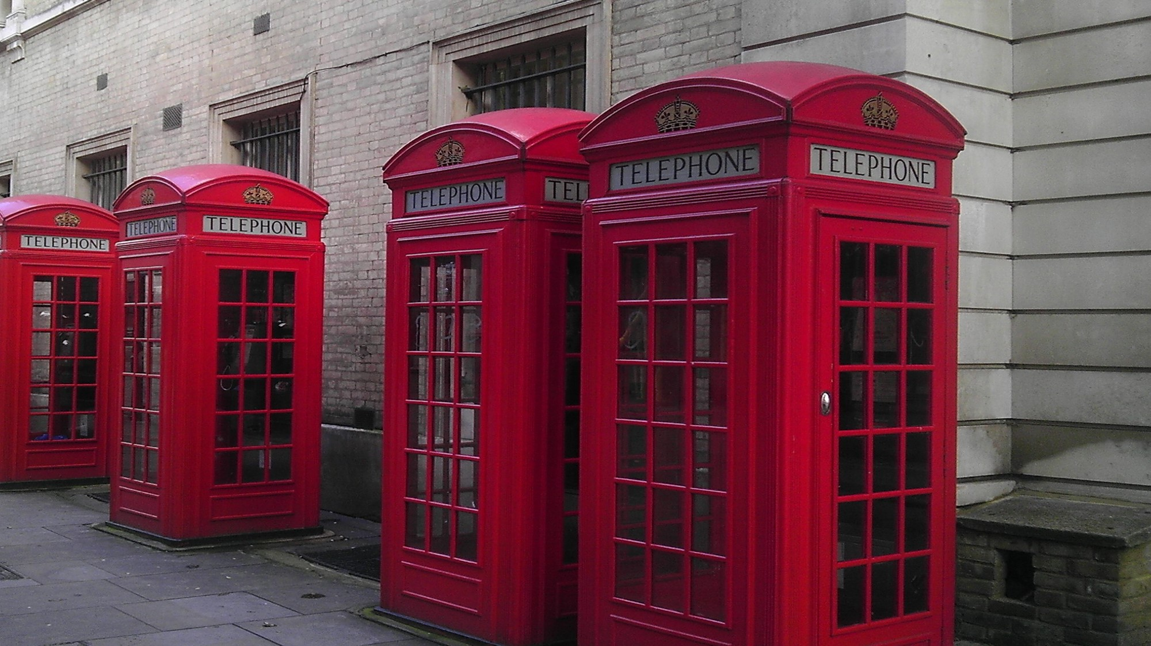
1
2
3
4
5
6
7
8
9
10
11
12
13
14
15
16
17
18

Slide 2
1
2
3
4
5
6
Natural
wind
solar
carbon
renewable
fossil
7
8
9
10
11
12
Nuclear
wind
Tidal
power
power
panels
13
14
15
16
17
18
17
fuels
power
turbines
energy
emissions
resources

