Slide 1


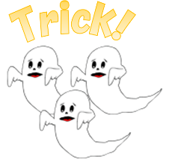
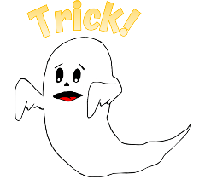

1
2
3
4
5
6
7
8
9
10
11
12
13
14
15
16
17
18
19
20
tekhnologic
Notes:
1 Ghost – 6, 9. 15, 16
3 Ghosts – 2, 13

Slide 2

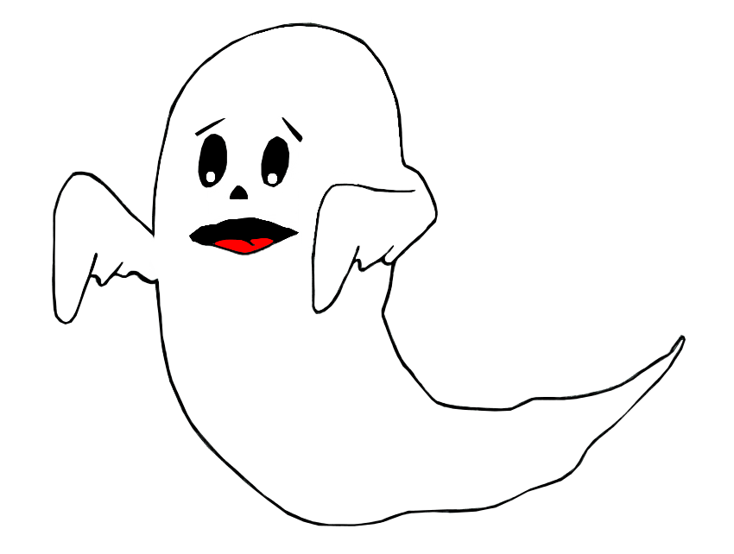

Trick!
Lose half your points!

Slide 3
Trick!
Lose all your points!

