Slide 1




What’s in the box?
I am strong
I am tall
I am handsome
Richard!
I am clever
I work in this classroom.

Slide 2


You take me to school
I am boring
You have me, but your parents don’t.
You don’t like me
homework!
Your teacher gives me to you

Slide 3
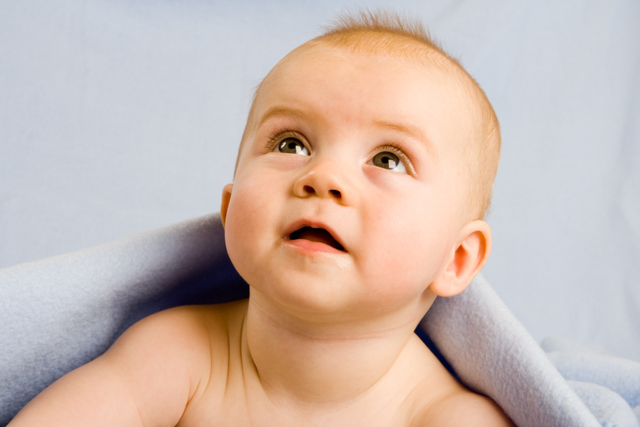
I like milk
I am cute
I am noisy
a baby!
I sleep alot.
I am small

Slide 4

I am different everyday.
I am black and white
I am light.
You can read me
a newspaper!
You can hold me in your hands.

Slide 5
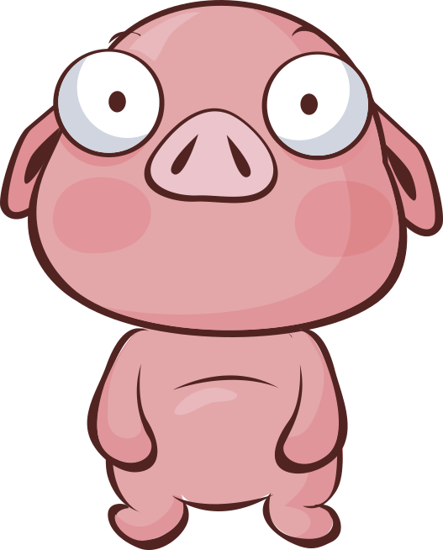
You can eat me.
I am delicious
I live on the farm..
I am dirty.
A pig!
I have 4 legs.
I am fat.

Slide 6
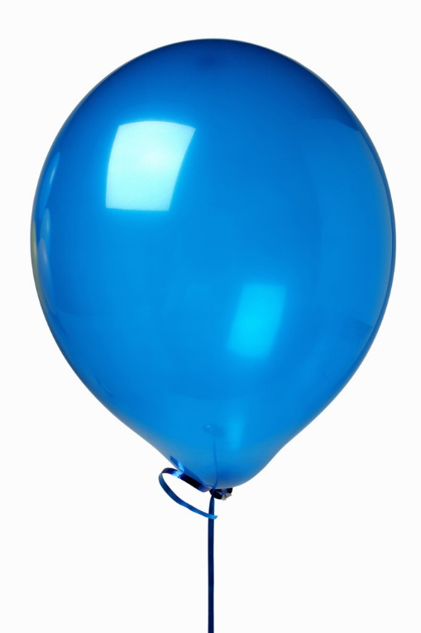
You can see me at parties
I can fly
I can grow and I can shrink.
I am light
A balloon!
I am usually quiet but sometimes very loud.
I am colorful

Slide 7

You take me to school
I am long
I am thin.
I live in a box
a ruler!
You use me to draw.
I am straight.

Slide 8
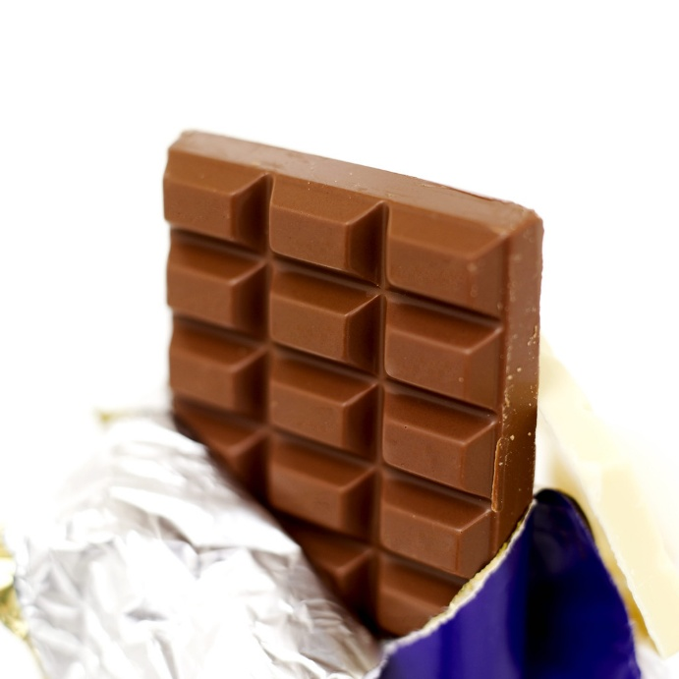

You can eat me.
I am delicious
.
You can drink me
chocolate!
You can buy me in the supermarket
I am hard when it’s cold and soft when it’s hot.

Slide 9

I can be hot and I can be cold.
I am dirty
I can kill you..
You don’t use me.
a cigarette!
Your teacher likes me
I smell awful.

Slide 10
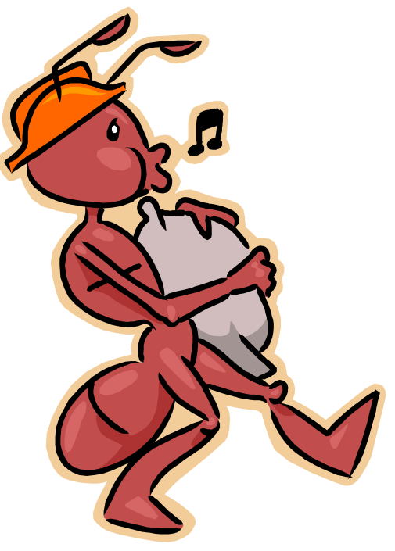
I like candy.
I am short
I have a large family.
You sometimes kill me
An ant!
I am small.
I work hard

Slide 11
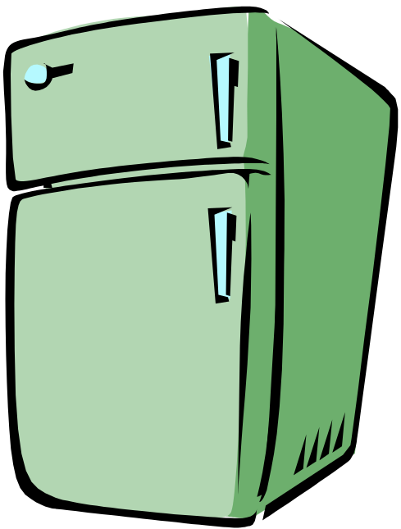
I am big
I am heavy
I am cold
a refrigerator!
I am white
I live in a house

Slide 12
You take me to school
I am boring
You have me, but your parents don’t.
You don’t like me
homework!
Your teacher gives me to you

Slide 13
You take me to school
I am boring
You have me, but your parents don’t.
You don’t like me
homework!
Your teacher gives me to you

Slide 14
You take me to school
I am boring
You have me, but your parents don’t.
You don’t like me
homework!
Your teacher gives me to you

Slide 15
You take me to school
I am boring
You have me, but your parents don’t.
You don’t like me
homework!
Your teacher gives me to you

Slide 16
You take me to school
I am boring
You have me, but your parents don’t.
You don’t like me
homework!
Your teacher gives me to you

Slide 17
You take me to school
I am boring
You have me, but your parents don’t.
You don’t like me
homework!
Your teacher gives me to you

Slide 18
You take me to school
I am boring
You have me, but your parents don’t.
You don’t like me
homework!
Your teacher gives me to you

